Slide 1

Starting Competitive
Programming
Presented by Alex Li

Slide 2
Getting started
Learn the basics of least 1 programming language
Bare minimum: Input, Output, Arrays, Loops
Nearly complete list: List, Map, Set, Queue, Stack
Most common languages: C++, Java, Python
Setup:
Not fun to do >:(
C++ : Recommend sublime text + the command line (maybe)
Java: Recommend to use eclipse or intellij
Python: Recommend to use pycharm

Slide 3
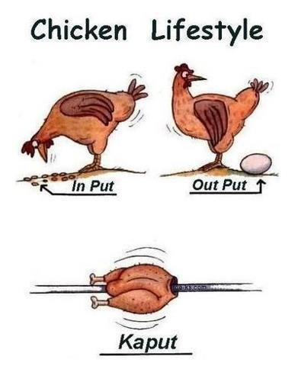
Doing Input and Output
Here are 3 solutions to a very basic problem, in c++, python, and java.
Problem: https://open.kattis.com/problems/r2
Solutions:
https://github.com/OSUACM/Weekly_Events

Slide 4
Speed
Try to run less than 10^8 lines of code in the worst case.
Example: Count the number of pairs (i, j) in an array with up to 10^5 elements where a_{i} < a_{j}.
Use other libraries to increase your coding speed :P
Memory limits

Slide 5
Big numbers
Sometimes, numbers given will be very large, and you need to make sure that nothing will overflow.
integer max size: 2^31 = ~ 2*10^9
long max size: 2^63 = ~8*10^18
Even bigger numbers?

Slide 6
Other Resources
Codeforces
Book explaining a lot of common techniques

